Slide 1
Structural constraints and individual agency in delivering compassionate care
A report of the National Evaluation of the Compassion in Practice Vision and Strategy in England.
Professor Helen Allan and Mike O’Driscoll
Centre for Critical Research in Nursing and Midwifery,
Middlesex University

Slide 2
Background
The Compassion in Practice Vision and Strategy in England emerged at a time when nursing and nurses in the UK were seemingly less trusted and subject to media reports of poor care (Paley 2014; Traynor 2014)
Similar concerns with standards of nursing care have been raised internationally (Dewar & Christley 2013).

Slide 3
Compassion in Practice Vision & Strategy (NHSE 2012)
In 2012 the Compassion in Practice: Nursing, Midwifery and Care Staff Vision and Strategy was launched by Jane Cummings, CNO, NHS England/Department of Health.
Shared purpose of nurses, midwives and care staff to deliver high quality, compassionate care, and to achieve excellent health and wellbeing outcomes.
The ‘enduring’ values of the 6 Cs; Care, Compassion, Competence, Communication, Courage and Commitment.

Slide 4
Aims of this presentation
Present findings from a national evaluation of the Impact of the Compassion in Practice Vision & Strategy (NHSE 2012) on nursing, midwifery and care staff
Discuss the structural constraints against which nurses deliver care and the limits of individual agency to be compassionate

Slide 5
Timeline
Compassion in Practice Evidencing the Impact May 2016 NHSE
Phase 1 Evaluation of programme outputs by trust
Phase 2 Evaluation of staff experiences (Middlesex University evaluation)
Phase 3 Evidencing the Impact

Slide 6
Methods and analysis
A mixed methods design with four sequential stages:
Analysis of national survey of nurses, midwives, care staff and health professionals including open-ended responses
Literature scoping - not reported here
Case studies (n=10) qualitative telephone interviews (n=) – not reported here
Secondary data analysis Family & Friends Test (FFT), Staff Family and Friends Test (SFFT) and NHS Staff Survey (NHSSS)
Integrated analysis of all data sources.

Slide 7
Survey
2014 CiP Survey by NHSE ‘Has Compassion in Practice made a difference to the people we care for and our staff?’
The sampling frame was all NHS trusts listed on NHS Choices website (n=235)
A 25.5 % random sample (n=60) stratified by speciality (acute, community and mental health)
62% (n=37) of the 60 Trusts which were sampled agreed to participate in the evaluation (this equates to 15.7% of all Trusts in England at time of survey)
Data collection in June/ Jul 2015

Slide 8
Total survey responses n=2,267

Slide 9
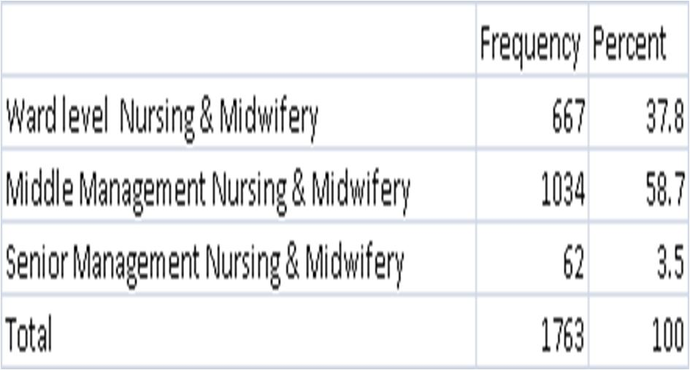
Recoded survey responses (n=1,763)

Slide 10
Profile of survey respondents
.

Slide 11
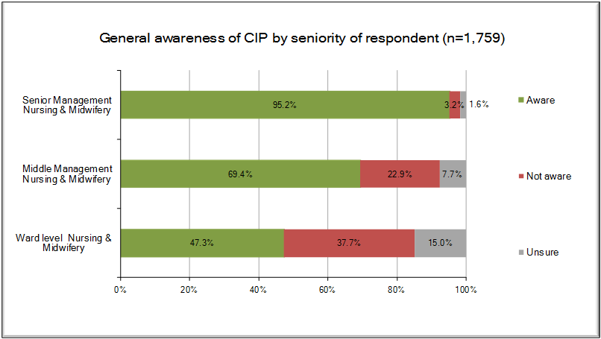
Awareness of CiP by seniority

Slide 12
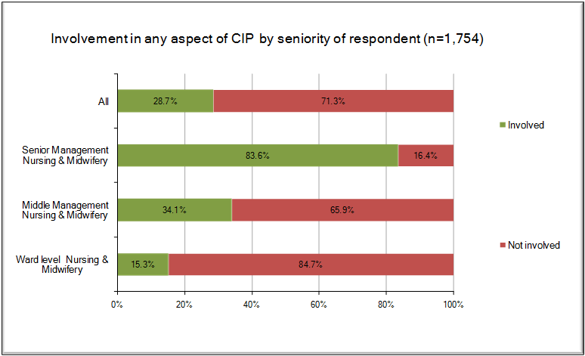
Involvement in CiP by seniority of respondents
.

Slide 13
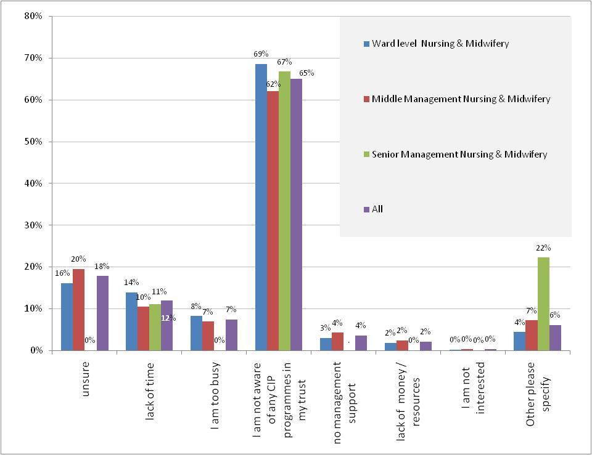
Reason for not being involved in CiP by seniority of respondents (Base: All respondents not involved in CiP and who identified their level of seniority n=1,102)

Slide 14
Some positive outcomes of CiP – views of those who HAD heard of CiP (n=1,759)
79.6% of all respondents (in the 3 groups – ward, middle management, senior management) felt that CiP was useful in supporting nurses
The CiP Strategy has the ability to improve the delivery of patient care mean 4.01
The CiP Strategy has helped to improve the patient experience 3.72
The CiP Strategy has positively influenced my actions in delivering compassionate care 3.70
The CiP Strategy has supported me as a 3.58
The CiP Strategy has made a positive difference to my overall experience as a nurse/midwife 3.44

Slide 15
Many staff felt that they were already delivering care in ways consistent with CiP ‘competencies’ base = all those NOT aware of CiP
Please indicate to what extent you agree or disagree with each statement | Ward level Nursing & Midwifery | Middle Management Nursing & Midwifery | Senior Management Nursing & Midwifery | All | N | p on KW test
The CiP Strategy has made me think about how I deliver compassionate care | 3.82 | 3.84 | 4.20 | 3.85 | 1081 | 0.003
The CiP Strategy has helped to improve the patient experience | 3.72 | 3.84 | 4.28 | 3.83 | 1070 | 0.000
The CiP Strategy has positively influenced my actions in delivering compassionate care | 3.68 | 3.68 | 4.02 | 3.70 | 1073 | 0.014
The CiP Strategy has promoted a culture of compassionate care for nurses, midwives and care staff in my organisation | 3.52 | 3.68 | 4.05 | 3.65 | 1060 | 0.000
The CiP Strategy has supported staff development | 3.51 | 3.67 | 4.16 | 3.65 | 1069 | 0.000
The CiP Strategy has supported me as a nurse/midwife/care staff | 3.48 | 3.57 | 4.17 | 3.58 | 1074 | 0.000

Slide 16
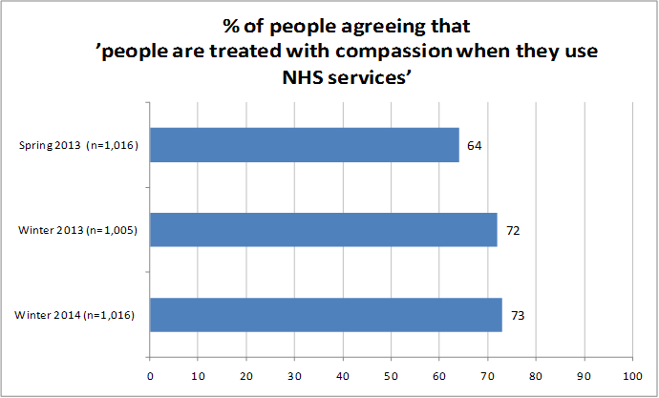
And there is some reason to think that the staff views are based in reality…(MORI 2014)

Slide 17
Summary of open ended responses
Awareness of CiP and involvement in CiP were low and varied to a statistically significant extent on the basis of role.
Despite low levels of awareness and involvement many research participants felt that they were delivering compassionate care in the ways specified in CiP.
Anxiety, anger and distress about the messages that CiP gives out internally to the profession and externally to patients.
Many participants felt that individual agency in relation to delivering compassionate care was being stressed rather than structural constraints on delivering compassionate care which were seen as primarily to do with resourcing
There was a strong message from staff, with some support from secondary data, that compassion for patients is only sustainable where there is compassion for staff. Many participants expressed directly or indirectly that they did not feel they were being treated with compassion.

Slide 18
Value of the 6 Cs
Overall staff felt the 6Cs had helped to focus and highlight their work.
“It’s something I feel is very important. The 6Cs encapsulated everything, but it’s something I’ve been concerned about for a while, that nurses are becoming very technically proficient in many ways, but that the fundamental essentials of being a nurse and coming across as a nurse who can be approached, relied upon, friendly, knowledgeable - if they don’t know, they’ll put you in touch with someone who can - is perhaps beginning to be missed a little bit, not just within this Trust, I feel nationally” (Site 5)

Slide 19
Structure and culture
Structural issues (high workload, lack of resources, paperwork) shape the delivery of compassionate care.
“Although most staff are aware of the Compassion in Practice, not enough is really known at floor level. The majority of the nursing staff always work to their extreme best in delivering care to patients. Lack of resources, equipment and the constant movement of having to outlie patients instead of caring for them in a safe environment often results in the interruption of the continuation of care and delays safe discharging.”(14 Nursing middle management)
Cultural change (prevent bullying, support ward level staff) is required to support compassionate care delivery.
“We are still working in a culture driven by anxiety and defensiveness which works against the ability to give compassionate care. Until the blame culture is widely discussed nurses don’t feel supported or safe and are over anxious.” (413 Nursing ward level)

Slide 20
Demoralising effect of Francis
Our findings should be viewed in the context of discourses on compassion and recent literature on the Francis Report.
“When I read the Francis report and it was one of those that I had to go back to and read in bite-sized chunks because a lot of it didn’t make pleasant reading as you know (Site 2).

Slide 21
Conclusions 1
Communication about Compassion in Practice could be cascaded more effectively across the NHS to share good practice
Compassion in Practice must be developed and extended to all staff so that it becomes embedded across all roles and all types of Trust

Slide 22
Conclusions 2
Barriers to compassionate care need to be addressed at individual agency AND structural levels
To focus purely on individual agency implies that all that is required for compassionate care is for staff to change their attitudes or behaviour when clearly this would not be sufficient condition for more compassionate care
Staff were clear that they were already delivering compassionate care and that although staff could improve their understanding & delivery of compassionate care, the most significant barriers to this were resources and management styles (i.e. structural)

Slide 23
Conclusions 3
Even if one accepted that change in individual agency was the correct level at which to address Compassion in Practice, communications between management and ward level staff were so poor so that awareness and involvement in the CiP initiative were low. So CiP had limited potential to inform or impact on individual behaviour or attitudes
Recognition and action is needed at the Trust leadership level and from NHS England to address the challenges staff face to deliver care, including a bullying work culture and structural constraints related to staffing levels and funding

Slide 24
References
Allan, H.T, O’Driscoll, M., Corbett, K., Liu, L. (2016) Evaluation of the National CiP Vision & Strategy – Full Report, Middlesex University
Dewar B and Christley Y (2013) A critical analysis of compassion in practice, Nursing Standard, 28 (10) 44-49
MORI (2014) Public Perceptions of the NHS and Social Care - Winter 2014 https://www.ipsos-mori.com/Assets/Docs/Publications/SRI_Health_NHS_Tracker_Winter_Tables_2014.pdf Accessed 25.2.17
NHS England/Professor Laura Serrant (2016) Compassion in Practice - Evidencing the impact https://www.england.nhs.uk/wp-content/uploads/2016/05/cip-yr-3.pdf Accessed 25.2.17
Paley J (2014) Cognition and the compassion deficit: the social psychology of helping behaviour in nursing. Nursing Philosophy 15(4) 274-87.
Traynor M (2014) Caring after Francis: moral failure in nursing reconsidered. Journal of Research in Nursing, 19, 7-8: 546-556.

Slide 25
or contact: h.allan@mdx.ac.uk m.o’driscoll@mdx.ac.uk
Presentation and full evaluation report available at site below from 7th April https://tinyurl.com/lwve7jj
Or scan QR code with your phone:

